Slide 1
19CSE303-Introduction to Embedded System

Slide 2
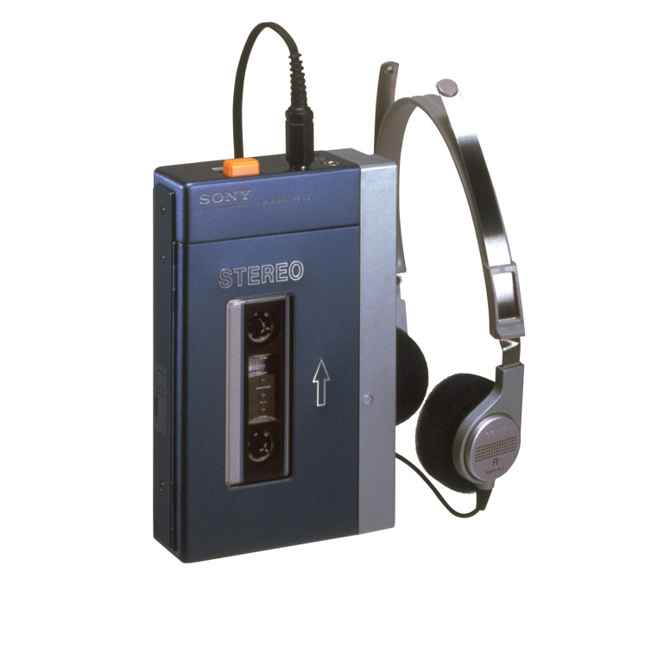
Walkman cassette-based

Slide 3
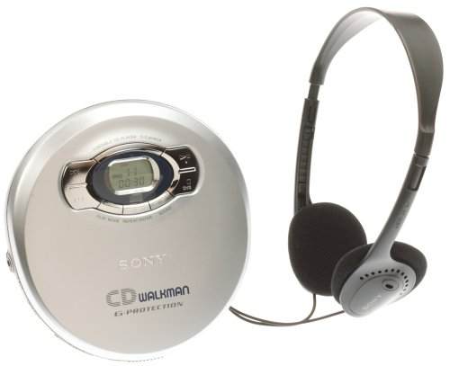
CD Walkman

Slide 4
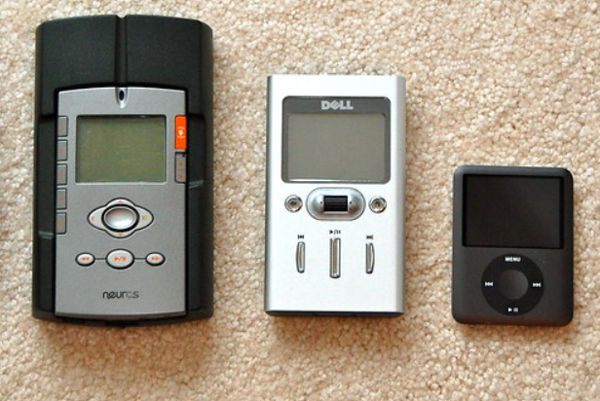
Digital Audio Players

Slide 5

Smartphones and Convergence

Slide 6


Slide 7
What is an Embedded System?
An embedded system is a combination of computer hardware and software designed for a specific function.
An embedded system is a microprocessor-based computer hardware system with software that is designed to perform a dedicated function, either as an independent system or as a part of a large system.
An embedded system is a microcontroller or microprocessor based system which is designed to perform a specific task

Slide 8
Common Features of Embedded Systems
Designed to perform specific repeated functions on certain single-purpose devices
Should perform their functions quickly, sometimes within a prescribed timeframe
Based on microprocessors and microcontrollers
May work without operating systems or use special OSs, quite often real-time operating systems (RTOS)
Work with limited memory, power and computing resources
May or may not have a keyboard, screen, user interface, connectivity

Slide 9
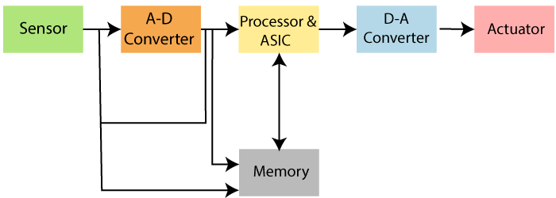
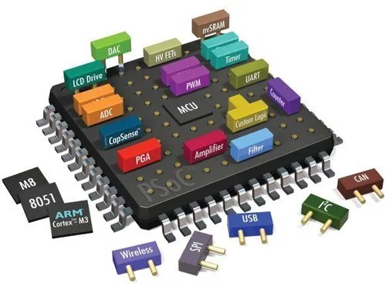
Basic Structure of an Embedded System

Slide 10
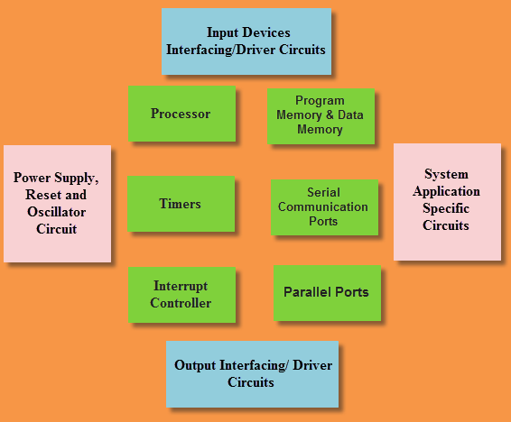
Basic Structure of an Embedded System

Slide 11
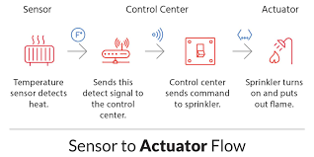
Basic Structure of an Embedded System
memory devices for data storage
I/O devices for input and output operations
computer buses for transferring data between hardware components
sensors for converting physical data into analog electrical signals
analog-to-digital converters (ADC) for transforming analog electrical signals (e.g. sound or light) into digital ones that the processor can read
digital-to-analog converters (DAC) for transforming digital signals from the processor into electrical ones
actuators for making mechanisms function based on the signal from the processor, for example, making a motor move
peripherals (cameras, printers, scanners, keyboards, etc.).

Slide 12
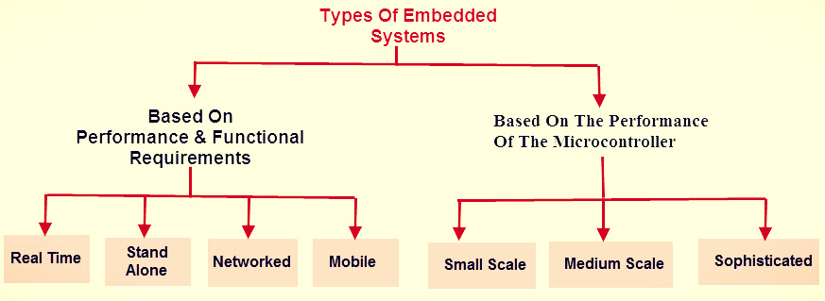
Type of Embedded System

Slide 13
Type of Embedded System
Real-time embedded system:
Real-time systems are those which give a quick response to critical situations. They are used in military, medical and industrial applications.
Radio, satellite and telephone communication
Patient monitoring system
Standalone embedded system:
This type of embedded system works for itself as a device without needing any interconnected computer. It can take data in the form of analog or digital signals. This system first process data and then outputs data by displaying on the screen.
Microwave ovens
Digital cameras
Networked embedded system:
Networked embedded systems are those systems which are connected to the network to give output to the attached resources.
In office security system, different sensors (light sensors, smoke sensors or motion detectors) are networked together through LAN and controlled over the WAN (internet)

Slide 14
Type of Embedded System
Mobile embedded system:
Mobile embedded systems are limited in resources including memory.
Cellular phones
Mp3 players
Digital cameras
Small-scale embedded system:
Small-scale embedded systems consist of 8-16 bit microcontroller. This system can perform tasks at a small level. They have on-chip ROM and RAM. Small-scale systems can be even activated by the battery.

Slide 15
Type of Embedded System
Medium scale embedded system:
This embedded system has 16-32 bit microprocessor or microcontroller with external RAM and ROM They can perform medium to complex level works. The integration between hardware and software is complex in these embedded systems. Programming languages used to develop medium scale embedded systems include Java, C, Visual C++.
Sophisticated embedded system:
The embedded system which can do large-scale works with multiple 32-64 bit chips is known as sophisticated embedded systems. They can perform distributed work on a large scale. The complexity of hardware and software is very high in these systems.

Slide 16
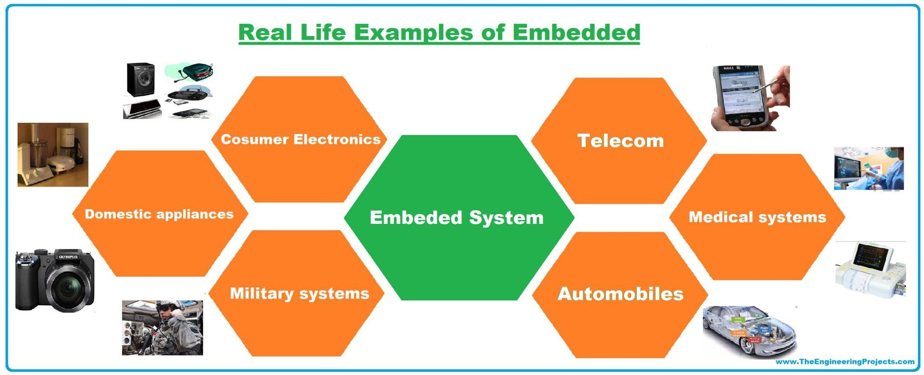

Slide 17
Applications of Embedded Systems
Embedded Systems in Automobiles and in telecommunications
Motor and cruise control system
Body or Engine safety
Entertainment and multimedia in car
Robotics in assembly line
Wireless communication
Mobile computing and networking
Embedded Systems in Smart Cards, Missiles and Satellites
Security systems
Telephone and banking
Defense and aerospace
Communication

Slide 18
Applications of Embedded Systems
Embedded Systems in Peripherals & Computer Networking
Displays and Monitors
Networking Systems
Image Processing
Network cards and printers
Embedded Systems in Consumer Electronics
Digital Cameras
Set top Boxes
High Definition TVs
DVDs

Slide 19
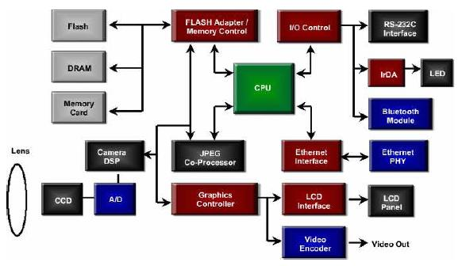
An Example Embedded System (Digital Camera Block Diagram)
Digital Camera Block Diagram

Slide 20
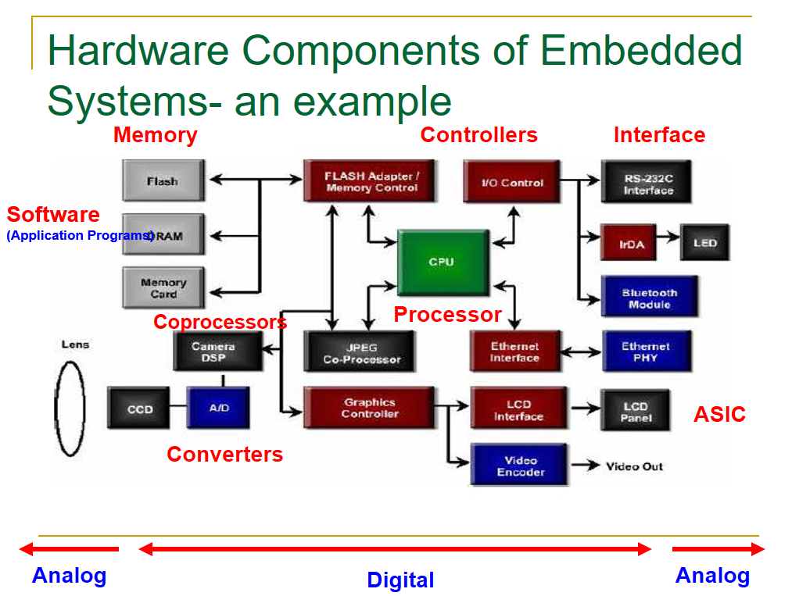

Slide 21
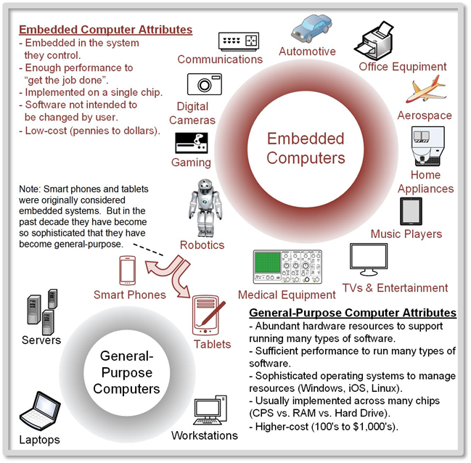


Slide 22
Thank you

